Slide 1
IMS IMPLEMENTATION LBO VS S8HR
CONDITIONS FOR PROVIDING VOLTE ROAMING
ARCHITECTURE AND ERROR CODES
CALLS MO /MT UNDER VOLTE IMS
FONCTION T-ADS ( knows if it is volte network or not )

Slide 2



Slide 3
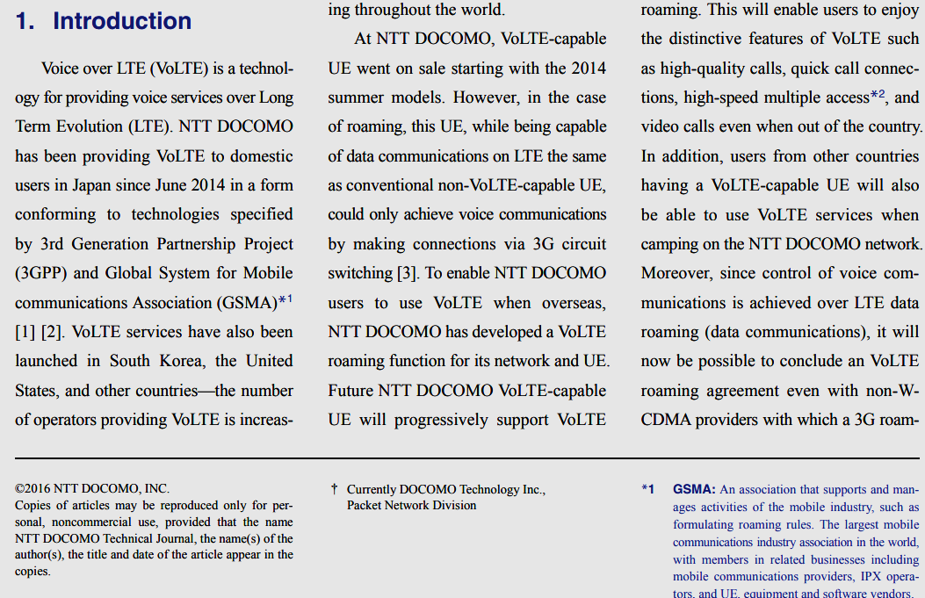

Slide 4
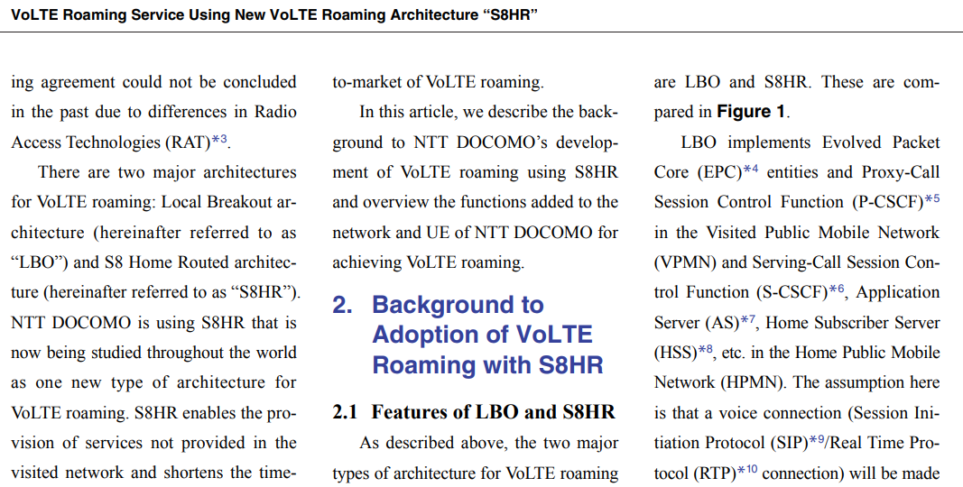

Slide 5
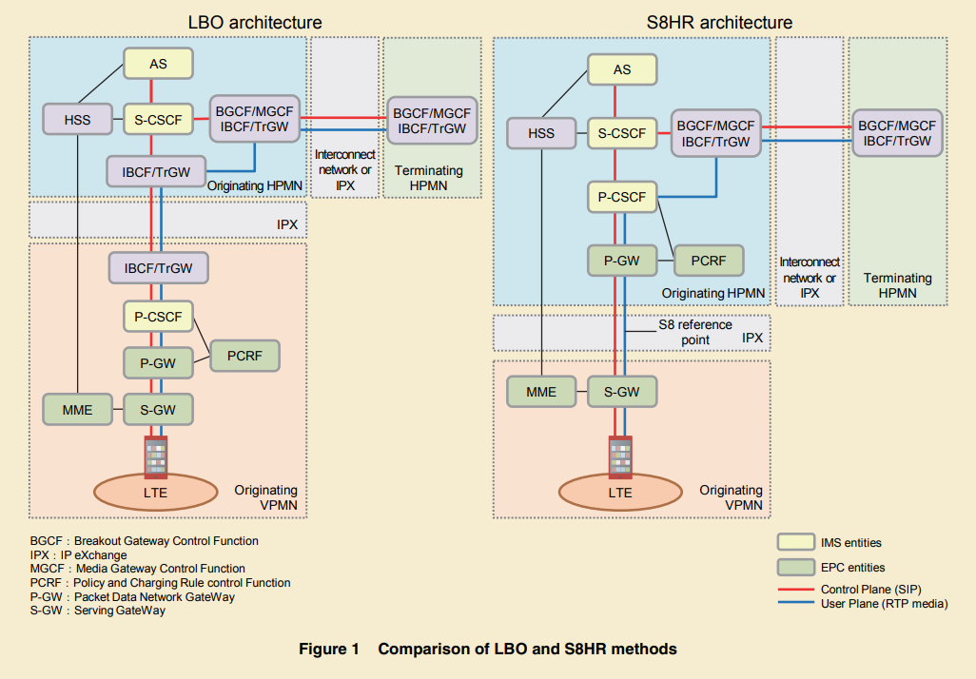
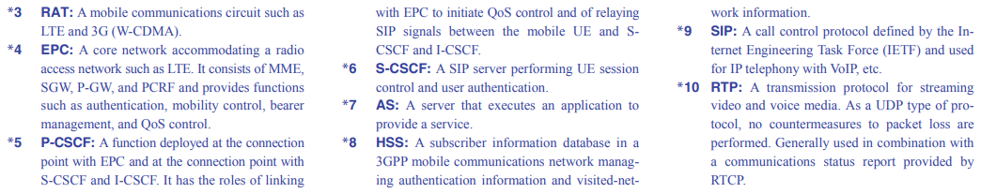
LOCAL BREAK OUT VS S8HR

Slide 6
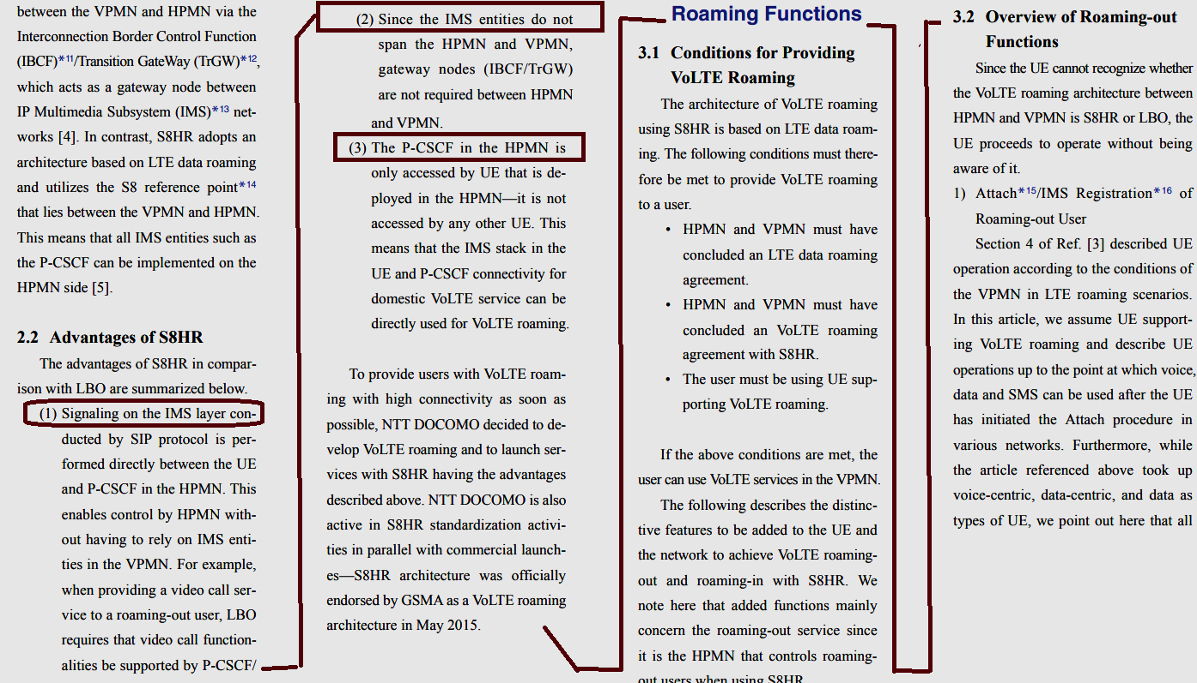
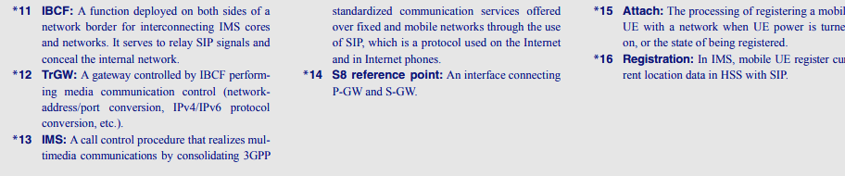

Slide 7
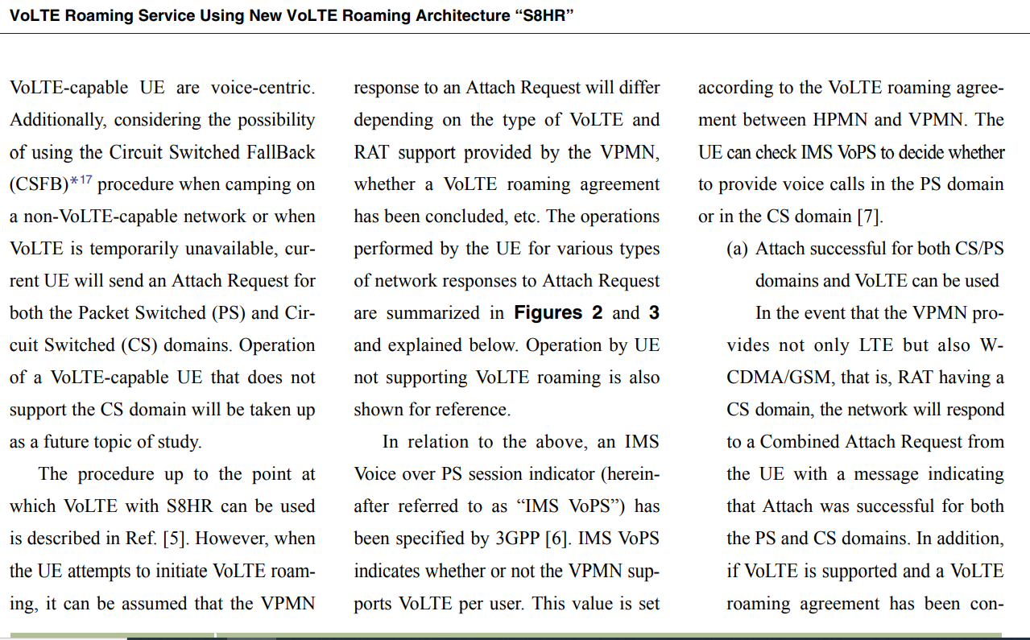

Slide 8
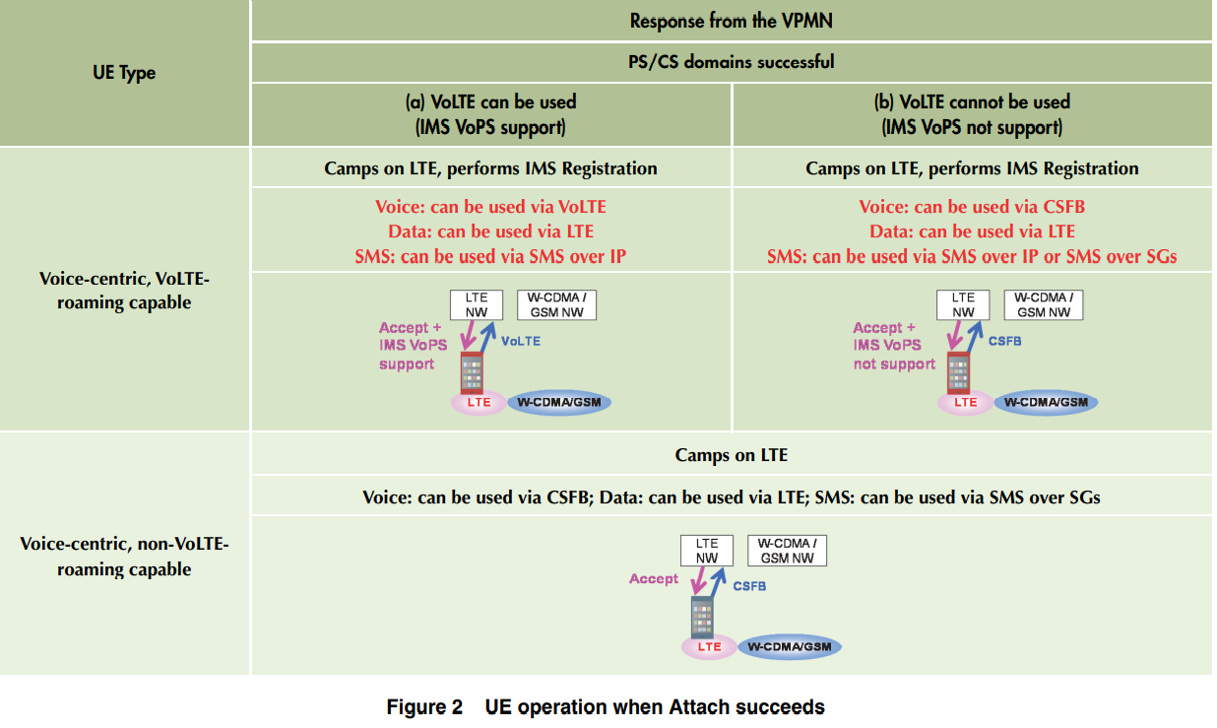

Slide 9
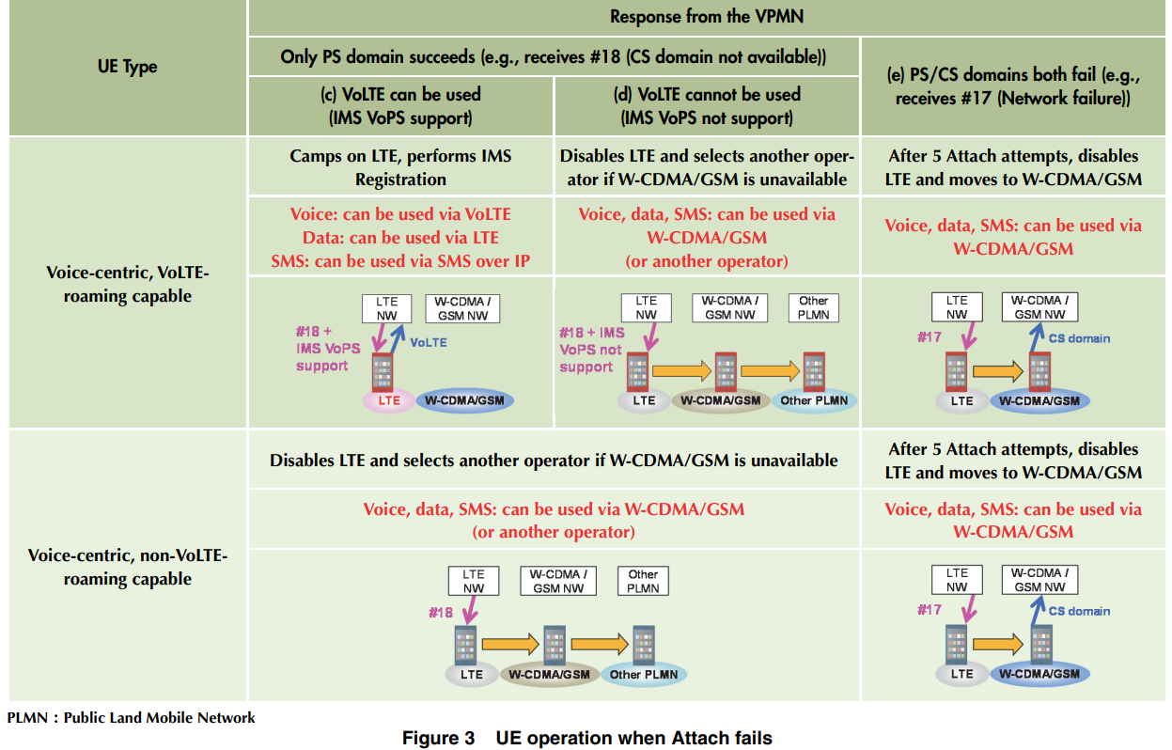

Slide 10
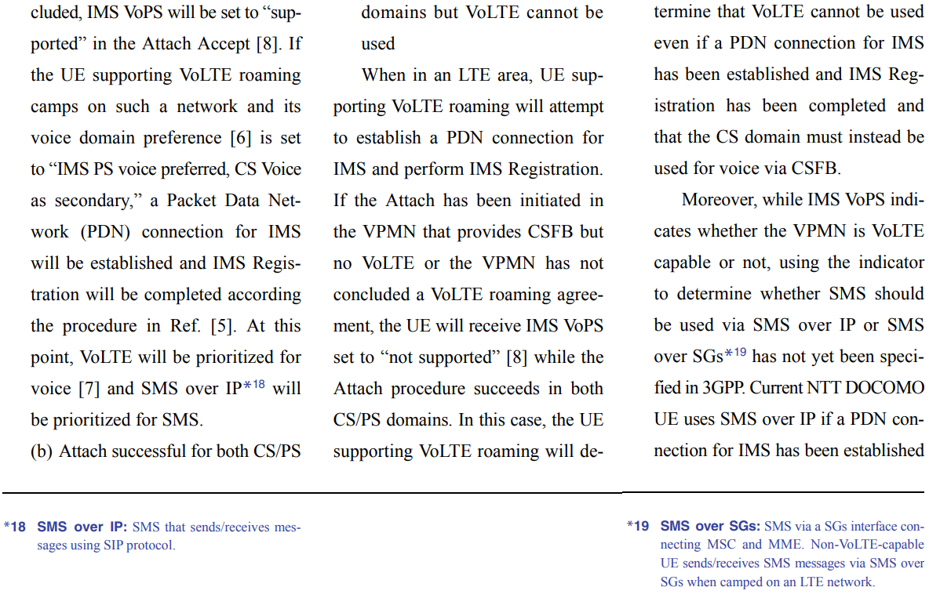

Slide 11
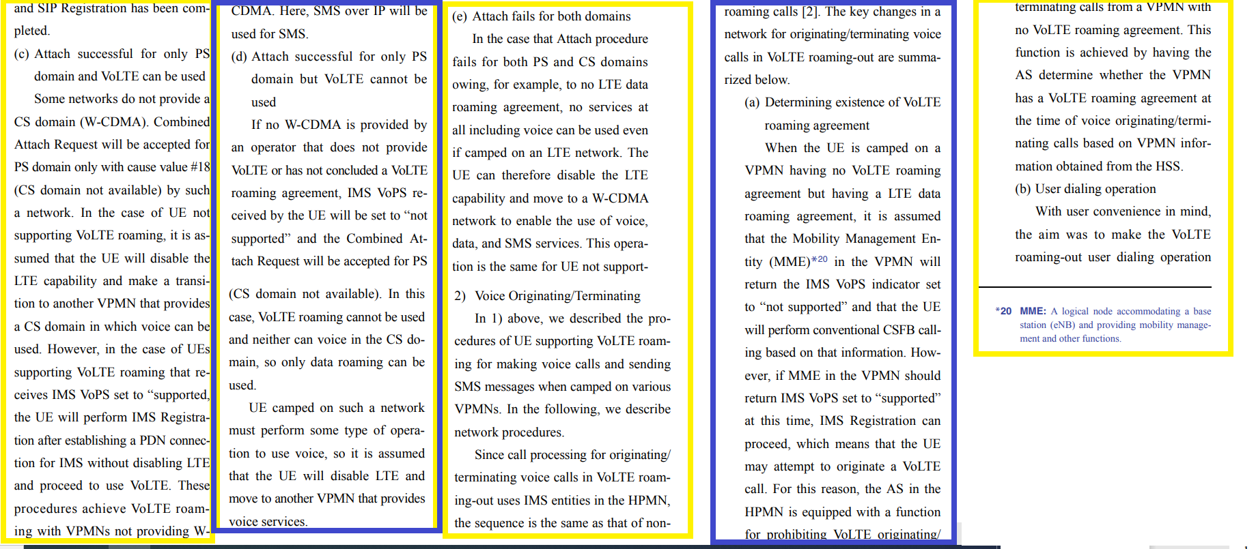

Slide 12
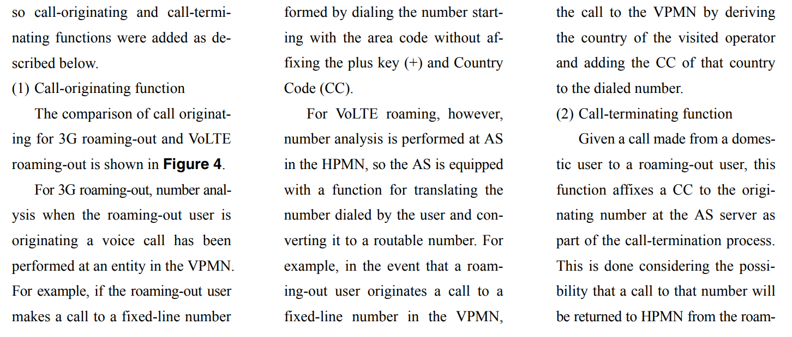
CALLS INITIATION UNDER VOLTE

Slide 13
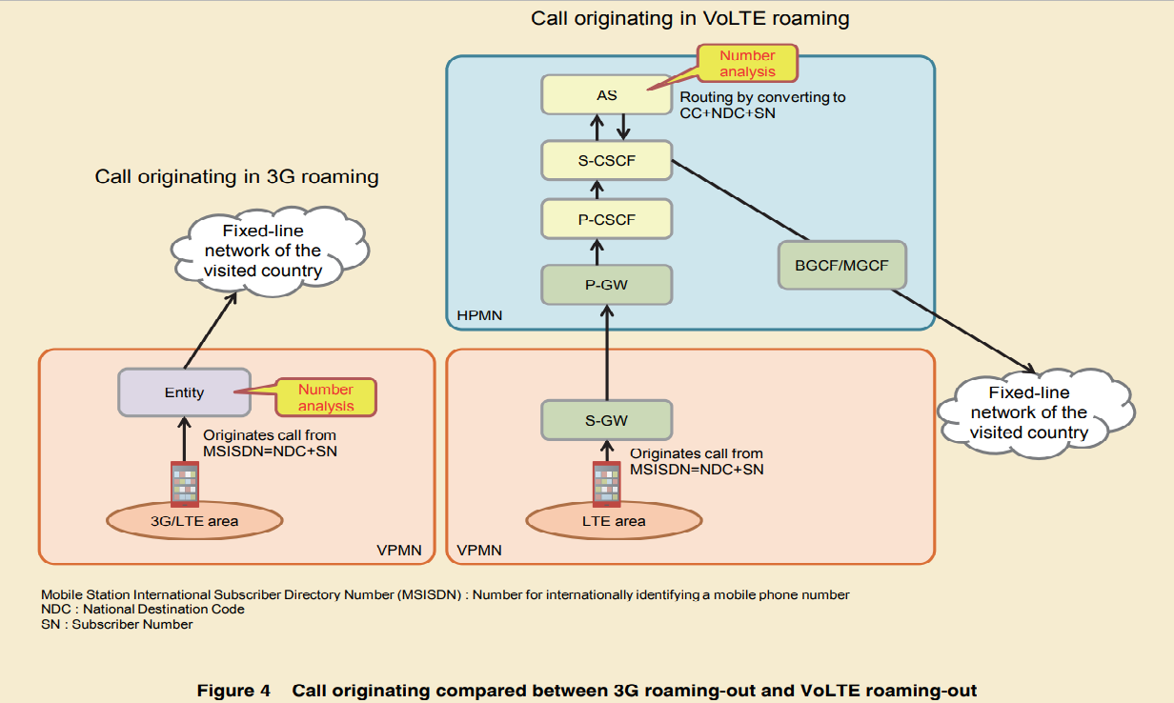

Slide 14
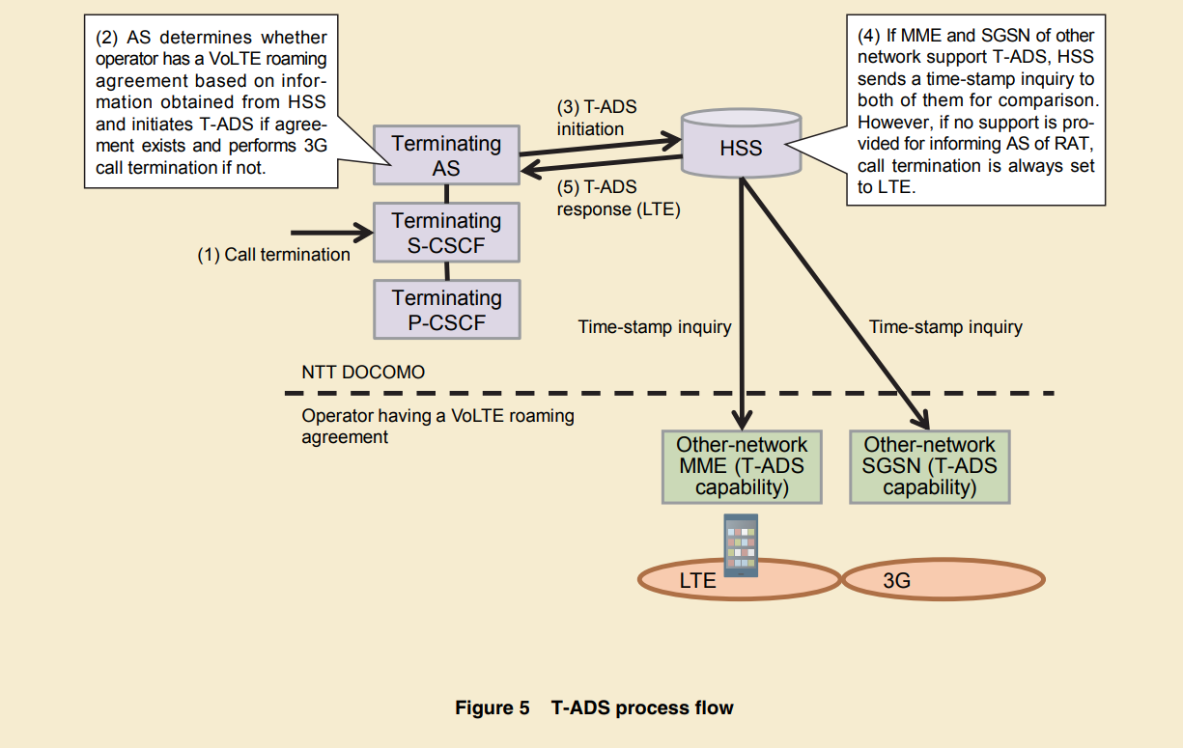
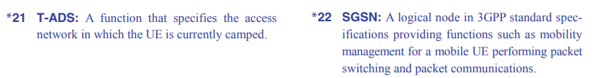
LA FONCTION TADS DETERMINE SI LE RESEAU EST VOLTE OU NON

Slide 15
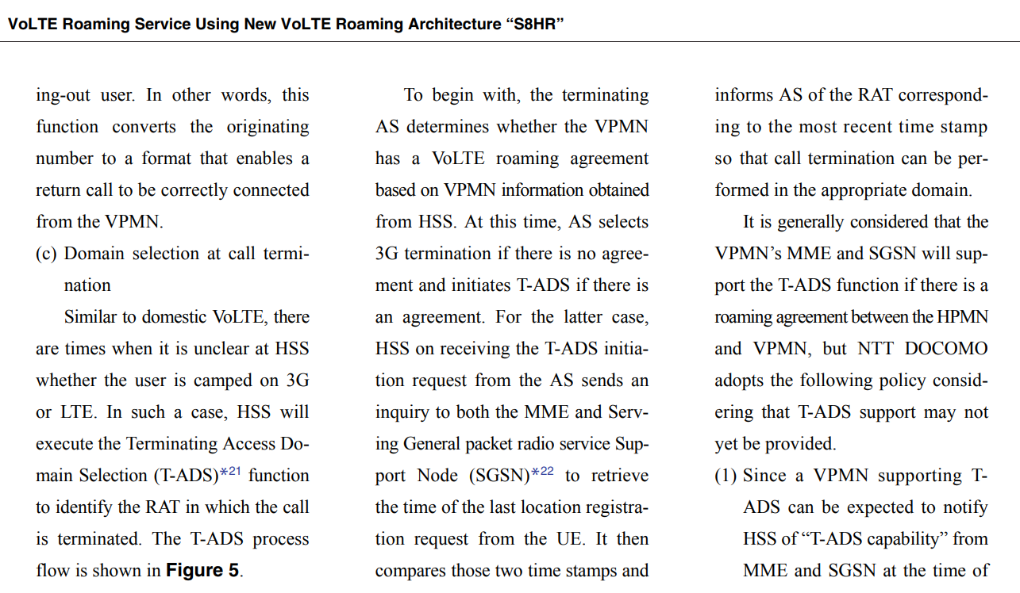

Slide 16
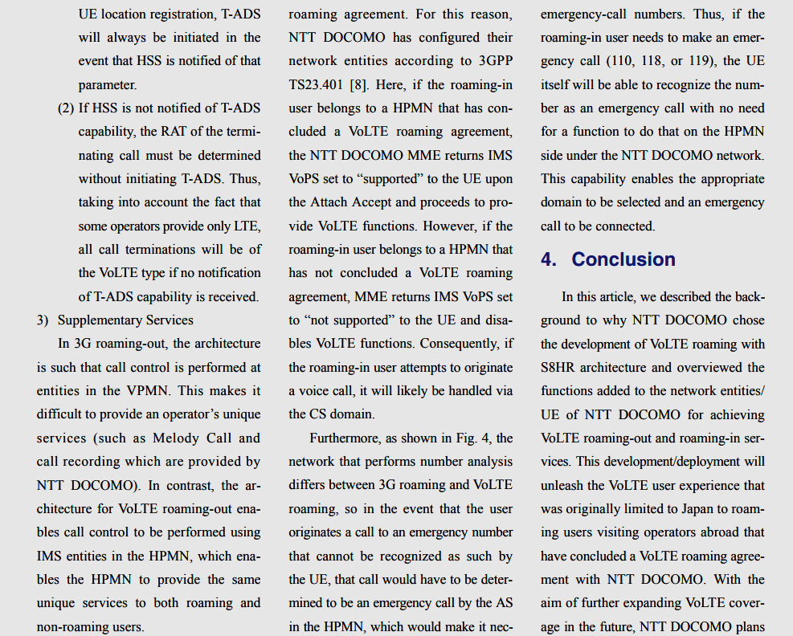

Slide 17
